Slide 1
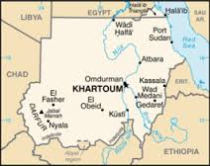
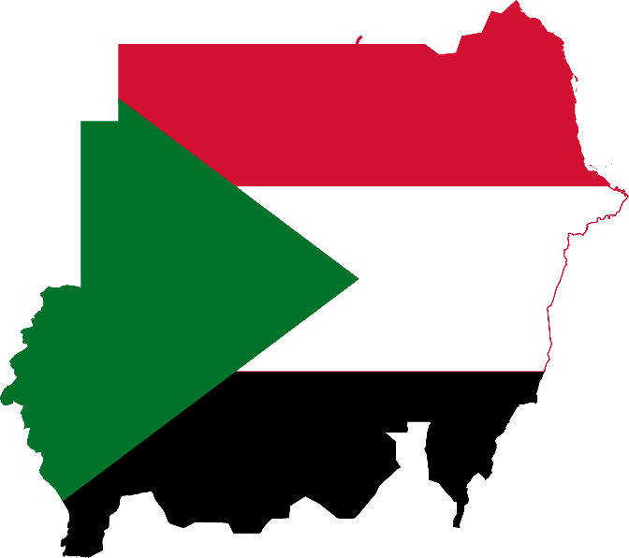
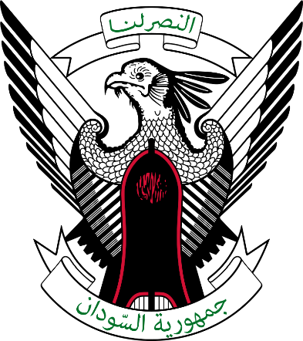
Republic of the Sudan

Slide 2
Sudan facts.
Located in Africa north East with 6 bordering countries + Red Sea
Ethiopia, Chad, Libya, South Sudan, Eritrea, Egypt.
World longest river throughout its country. The Nile (white & Blue)
Population: 39.79M ( Jan 2015) 40.65M ( Jan 2016)
Population Growth Rate: +/- 3% annually
Unemployment Rate 19.5 % (Khartoum 40%)
42.1% of population: under 15Y, 20% between 15 and 24
Median Age in Sudan: 19.8
Main language: Sudanese Arabic.
Capital: Khartoum
https://en.wikipedia.org/wiki/Category:Ethnic_groups_in_Sudan
http://countrymeters.info/en/Sudan

Slide 3
Sudan facts.
There are more pyramids in Sudan than in Egypt.
Sudanese weddings can last for up to a week.
Sudan dropped from being the largest to third largest country in Africa after the independence of South Sudan.
70% are Sudanese Arabs. Rest is ethnic groups like Beja, Nubians Copts Etc.
142 Ethnic groups in one country
95% Muslim
All religions have freedom to exist in Sudan
Country is a democracy with a every 4 years elected president
Till 1996 Osama Bin Laden was a resident of Sudan
https://en.wikipedia.org/wiki/Category:Ethnic_groups_in_Sudan
http://countrymeters.info/en/Sudan

Slide 4
History of Sudan.
Sudan’s earliest civilizations sprung up along the Nile, growing into the Kingdom of Kush during the 8th century BC. Kush conquered Egypt and adopted many facets of Egyptian culture, including burying its kings in pyramids found at Meroe. The region converted to Christianity in the AD 6th century, and then to Islam in the 14th century.
Modern Egypt conquered Sudan in the 1820s, turning the country into a slave market, but within 60 years jointly administered it with Britain, which was keen to control the area around the newly-built Suez Canal. Sudanese resistance against foreign rule was led by Mahdi Mohammed Ahmed, a figure revered as both a mystic and a holy warrior.
The Mahdist armies kicked both the Egyptians and British out, holding Khartoum until the British re-conquered the territory in 1898. By the mid-20th century, the Sudanese were once more clamoring for independence, which was granted in 1956.

Slide 5
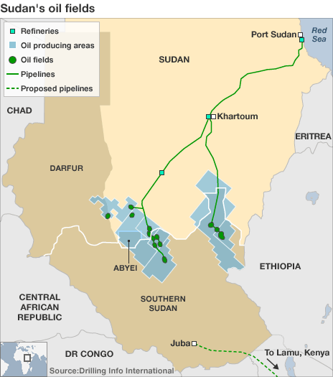
Sudan main source of income.
Oil industry . GNPOC as Main tool of Sudan Government.
Gold mining . (2016 Sudan is 3rd biggest net producer in Africa.)
Agriculture.
Livestock African 2nd biggest exporter of sheep.
Arabic Gum. (kordofangom)
Weapons manufacturing.
Others.
Uranium
Copper
Usd to SDG exchange rate bank 6.414 open market 15.20
Inflation rate +/- 18.15% annually
Ease of doing business index nr159
Corruption index nr 11

Slide 6
Sudan main source of income.
he following 142 pages are in this category, out of 142 total. This list may not reflect recent changes (learn more).
A
Ababda people
Afitti people
Amarar tribe
Amdang people
Amri people
Armenians in Sudan
Artega tribe
Awlad Hassan
Awlad Mana
B
Baggara
Barabra
Batahin
Baygo people
Bedouin
Beja people
Beni-Amer people
Berta people
Berti language
Bidayat dialect
Bisharin tribe
Burun people
C
Copts
Copts in Sudan
D
Daasanach people
Daju people
Dar Fur Daju people
Debri people
Dilling people
Dinka people
Dubasiyin people
E
El Hugeirat people
Eliri people
Erenga people
F
Fezara people
Fongoro people
Fula people
Fungor people
Funj people
Fur people
G
Gawamaa tribe
Gberi people
Ghulfan people
Gimma people
Gule tribe
Gulud people
Gumuz people
H
Haddad people
Hadendoa
Hasania tribe
Hausa people
Hawawir people
Hedareb people
Heiban Nuba people
Homa people
Houara
Humur
Husseinat people
I
Ingessana people
J
Bedaria tribe
Ja'alin tribe
Jur Modo people
K
Kababish tribe
Kadaru people
Kanga people
Kara people
Karko people
Kawahla people
Keiga Jirru people
Keiga people
Kerarish people
Kimr people
Kineenawi people
Koalib Nuba people
Kresh people
Krongo Nuba people
Kuraan people
L
Lafofa people
Lahawin people
Laro people
Logol people
Logorik people
M
Maalia people
Maba people
Magyarab people
Mahamid
Manasir
Mararit people
Masalit people
Mesakin people
Midob people
Molo people
Moro Nuba people
N
Nuba peoples
Nubians
Nuer people
Nyimang people
O
Otoro Nuba people
P
Padang people
Pari people
R
Rashaida people
Rizeigat tribe
Romani people in Sudan
Rubatab tribe
Rufaa people
Ruweng people
S
Sara Gambai people
Sebei people
Selim people
Shaigiya tribe
Shatt people
Sherifi people
Shilluk people
Shukria clan
Shuweihat tribe
Shwai people
Sillok people
Sinyar people
Sungor people
T
Tagale people
Tagbu people
Talodi people
Tama people
Temein people
Tima people
Tingal people
Tira people
Tornasi people
Toubou people
Tukam people
Tulishi people
Tumma people
Tunjur people
Turum people
U
Uduk people
Umm Heitan people
V
Vidiri people
W
Welega Oromo people
Werni people
Wetawit people
Y
Yerwa Kanuri people
Yulu people
Z
Zaghawa people

